Slide 1

Janda Hejhal

Slide 2
WHAT IS ADDICTION ?
TYPES OF ADDICTION
HOW TO DEAL WITH ADDICTION ?
Janda Hejhal

Slide 3
Janda Hejhal
WHAT IS ADDICTION ?
TYPES OF ADDICTION
HOW TO DEAL WITH ADDICTION ?
WHAT IS ADDICTION ?

Slide 4
WHAT IS ADDICTION ?
TYPES OF ADDICTION
HOW TO DEAL WITH ADDICTION ?
LIFE AFFECTION
WHAT IS ADDICTION ?

Slide 5
TYPES OF ADDICTION
SUBSTANCE BEHAVIORAL
LIFE AFFECTION
WHAT IS ADDICTION ?

Slide 6
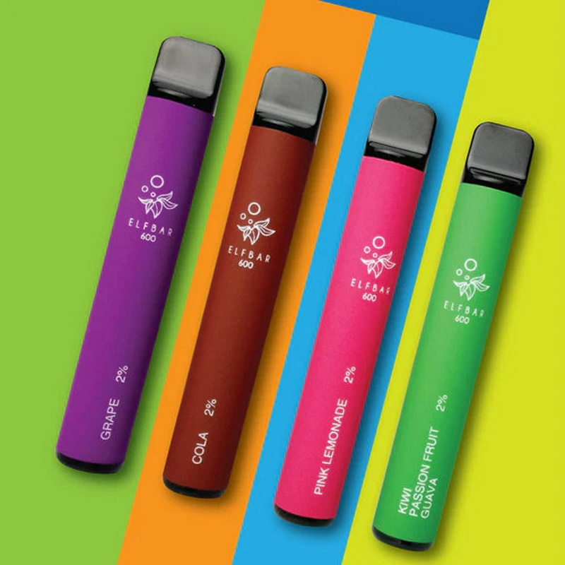



NICOTIN
CAFFEINE
GAMBLING
ALCOHOL
TYPES OF ADDICTION
SUBSTANCE BEHAVIORAL
LIFE AFFECTION

Slide 7
GAMBLING
TYPES OF ADDICTION
SUBSTANCE BEHAVIORAL
ALCOHOL
LIFE AFFECTION

Slide 8
NICOTIN
CAFFEINE
TYPES OF ADDICTION
SUBSTANCE BEHAVIORAL
GAMBLING
LIFE AFFECTION
ALCOHOL

Slide 9
NICOTIN
TYPES OF ADDICTION
SUBSTANCE BEHAVIORAL
CAFFEINE
LIFE AFFECTION
GAMBLING
ALCOHOL

Slide 10
NICOTIN
HOW TO DEAL WITH ADDICTION ?
CAFFEINE
GAMBLING
ALCOHOL

Slide 11
WITHDRAWAL
WITHDRAWAL SYMPTOMS
HOW TO DEAL WITH ADDICTION ?
NICOTIN

Slide 12
RELAPSE
CRAVINGS AND „JUST THIS ONE TIME“
WITHDRAWAL
WITHDRAWAL SYMPTOMS
HOW TO DEAL WITH ADDICTION ?

Slide 13
TREATMENT
PSYCHOTERAPIES, MEDICATION AND TIPS
RELAPSE
CRAVINGS AND „JUST THIS ONE TIME“
WITHDRAWAL
WITHDRAWAL SYMPTOMS

Slide 14
TREATMENT
PSYCHOTERAPIES, MEDICATION AND TIPS
RELAPSE
CRAVINGS AND „JUST THIS ONE TIME“
SUMMARY

Slide 15
TREATMENT
PSYCHOTERAPIES, MEDICATION AND TIPS
„I am not defined by my relapses, but by my decision to remain in recovery despite them.“.
SUMMARY

Slide 16
THANK YOU!
„I am not defined by my relapses, but by my decision to remain in recovery despite them.“.
SUMMARY

Slide 17
THANK YOU!
„I am not defined by my relapses, but by my decision to remain in recovery despite them.“.

