Slide 1
Apple INC.

Slide 2
General informations
Apple Inc. is an American multinational technology company headquartered in Cupertino, California
designs, develops, and sells consumer electronics, computer software, and online services
It is considered one of the Big Five technology companies, alongside Microsoft, Amazon, Google, and Facebook
The company's hardware products include: iPhone, iPad, Mac, iPod, Apple Watch,
Apple TV, Airpods, HomePod
The company´s software products include: macOS, iOS, iPadOS, watchOS, and tvOS
And also worth to mention: Shazam, Safari, iLife, iWork

Slide 3
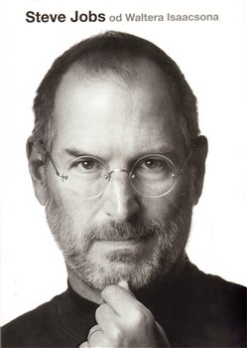
1. History of the company
Apple Computer Company was founded on April 1, 1976, by Steve Jobs, Steve Wozniak, and Ronald Wayne as a business partnership
The company's first product was the Apple I, a computer designed and hand-built entirely by Wozniak
In 1976, Steve Jobs co-founded Apple in his parents' home on Crist Drive in Los Altos, California, Jobs and Wozniak move some operations to the garage when the bedroom became too crowded
The Apple II, also invented by Wozniak, was introduced on April 16, 1977,
The company introduced the Apple III in May 1980
In 1984, Apple launched the Macintosh, the first personal computer to be sold without a programming language

Slide 4
2. History of the company
The success of Apple's lower-cost consumer models, especially the LC, also led to the cannibalization of their higher-priced machines
Apple also experimented with a number of other unsuccessful consumer targeted products during the 1990s, including digital cameras, portable CD audio players, speakers, video consoles, the eWorld online service, and TV appliances
At the August 1997 Macworld Expo in Boston, Jobs announced that Apple would join Microsoft to release new versions of Microsoft Office for the Macintosh, and that Microsoft had made a $150 million investment in non-voting Apple stock
On November 10, 1997, Apple introduced the Apple Store website, which was tied to a new build-to-order manufacturing strategy
2007, Jobs announced that Apple Computer, Inc. would thereafter be known as "Apple Inc.", because the company had shifted its emphasis from computers to consumer electronics Apple Inc. This event led to announcement of iPhone, Apple TV

Slide 5
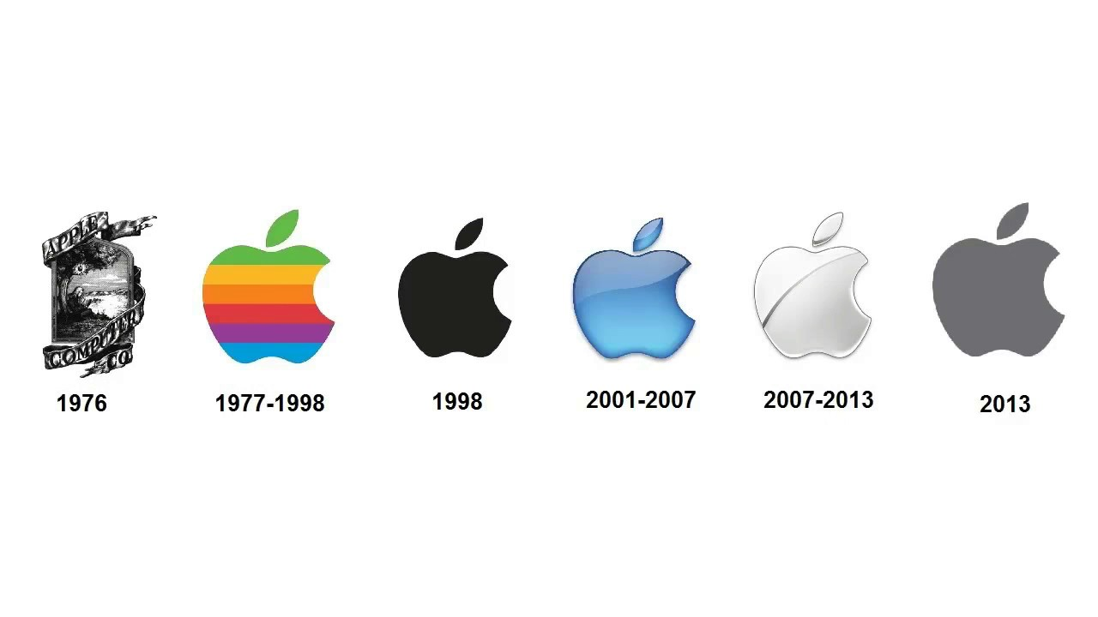
Present era ( post Jobs era)
On October 5, 2011, Steve Jobs died, marking the end of an era for Apple
From 2011 to 2012, Apple released the iPhone 4S and iPhone 5, which featured improved cameras, an intelligent software assistant named Siri
Also this era is character for its new technological features like: retina display (made from gorillaglass), iCloud
In March 2013, Apple filed a patent for an augmented reality (AR) system that can identify objects in a live video stream
Apple recruited Paul Deneve, Belgian President and CEO of Yves Saint Laurent as a vice president reporting directly to Tim Cook (present president and CEO)
In June 2017, Apple announced the HomePod, its smart speaker aimed to compete against Sonos, Google Home, and Amazon Echo

Slide 6
Products
Macintoshes
iPhone
iPad
iMac: Consumer all-in-one desktop computer, introduced in 1998
Mac Mini: Consumer sub-desktop computer, introduced in 2005
MacBook Pro: Professional notebook, introduced in 2006
Mac Pro: Workstation desktop computer, introduced in 2006
MacBook Air: Consumer ultra-thin, ultra-portable notebook, introduced in 2008.
the iPhone 7 and the iPhone 7 Plus, which feature improved system and graphics performance, add water resistance
the iPhone 8 and iPhone 8 Plus, standing as evolutionary updates to its previous phones with a faster processor
the iPhone XS, iPhone X Max and iPhone XR features super Retina displays, a faster and improved dual camera system
the iPhone 11, iPhone 11 Pro features the same Liquid Retina LCD display used in 2018's iPhone XR
second-generation iPhone SE. It replicates the iPhone 8 design - has a 4.7-inch screen, sizable bezels on the top and bottom
"the new iPad". It added LTE service from AT&T or Verizon, an upgraded A5X processor, and Retina display.
iPad Mini was introduced It featured a reduced 7.9-inch display
iPad Air and the iPad Mini with Retina Display, both featuring a new 64-bit Apple A7 processor
iPad Air 2 added better graphics and central processing and a camera burst mode
iPad Pro, an iPad with a 12.9-inch display that supports apple pencil
Apple Watch
Series 3 - LTE cellular connectivity, independence
Series 5 - new magnetometer, a faster processor
*these are products, which are currently available on the market

Slide 7
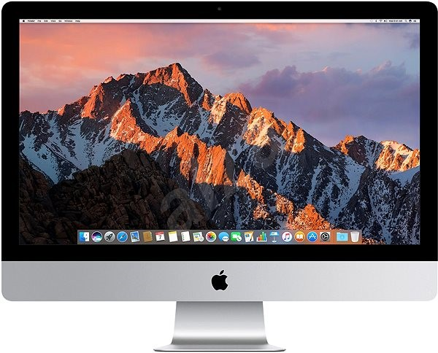
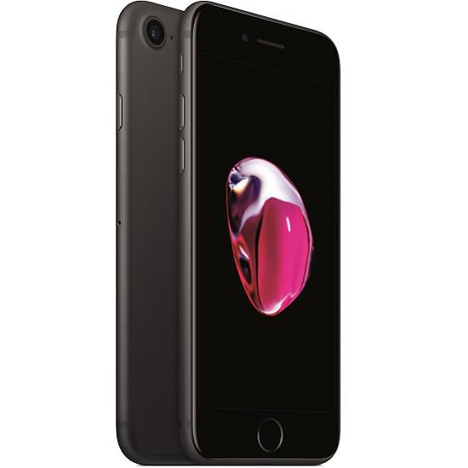
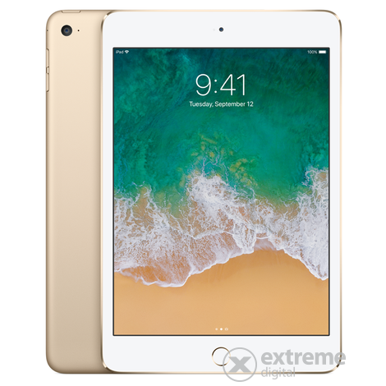
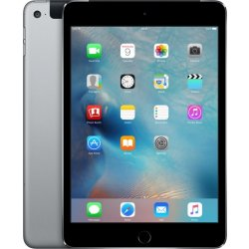
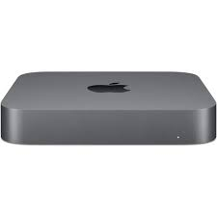
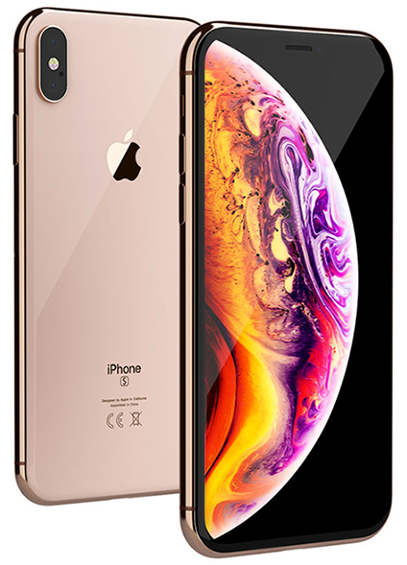
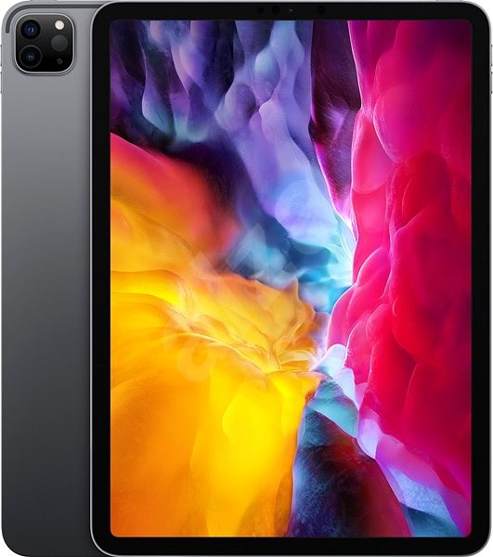
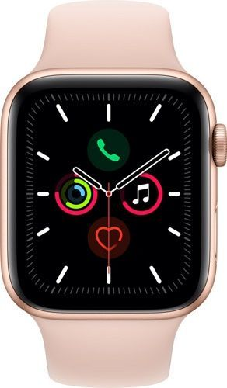
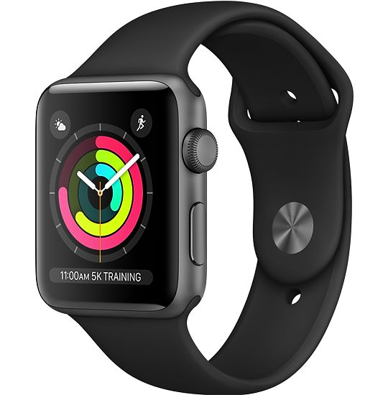
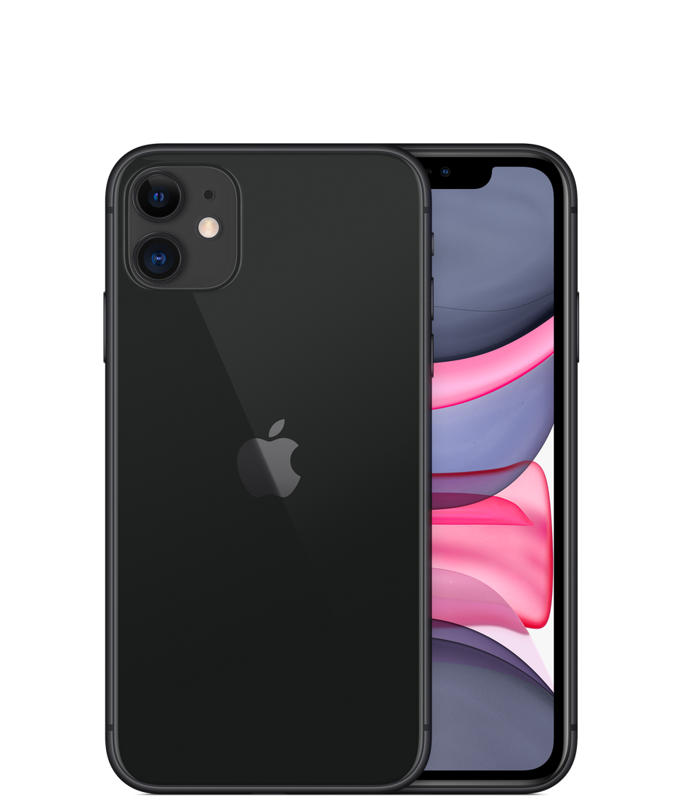
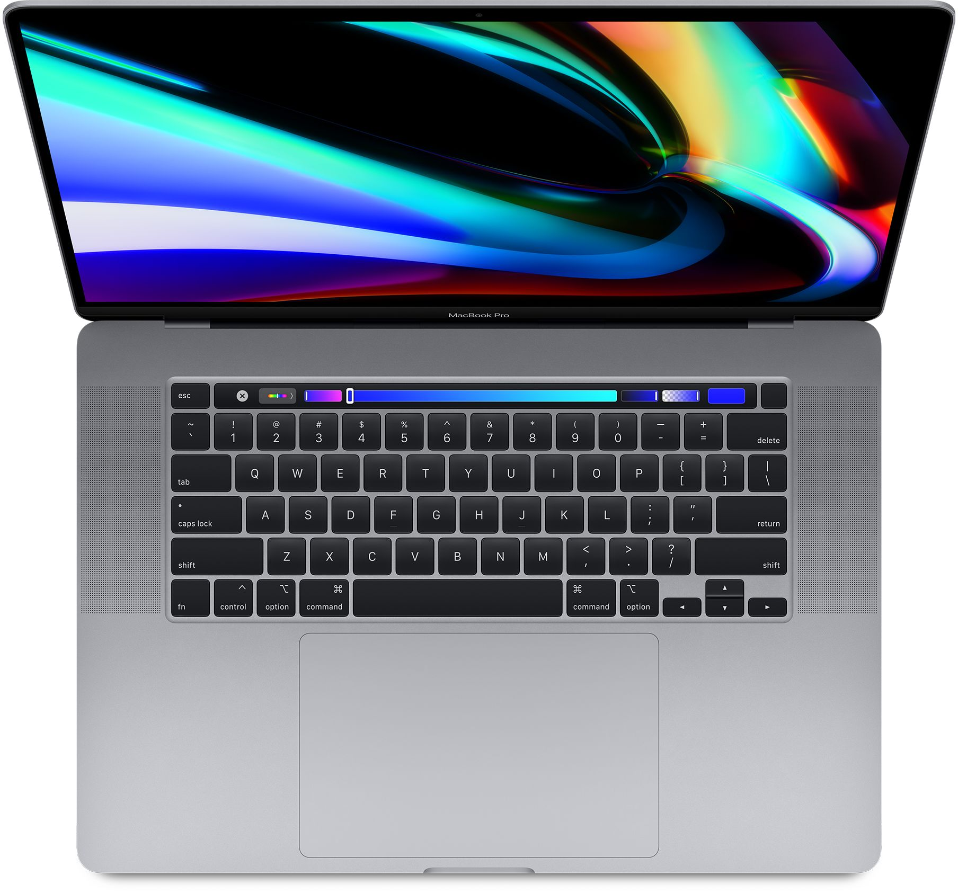
Products - pictures
iPhone 7
iMac
iPad Mini 4
iPad Air 2
MacMini
iPhone XS
Apple watch series 5
Apple watch series 3
iPad Pro 2020
MacBook Pro
iPhone 11

Slide 8
SWOT Analysis
STRENGTHS
Brand identity
Innovative products
Brand value reputation
Marketing advertising
Distribution chain
Customer focus
Weaknesses
Incompability
Matching customer expectations
Premium pricing
Lack of competiton
OPORTUNITIES
THREATS
Steady customer growth
Qualified professionals
Lack of green technology
Use of AR and artificial IQ
Electric apple car
Expand of distribution network
Counterfeit products
Laptop competition
Lawsuits
Market penetration
Rising labour costs in manufacturing countries

Slide 9
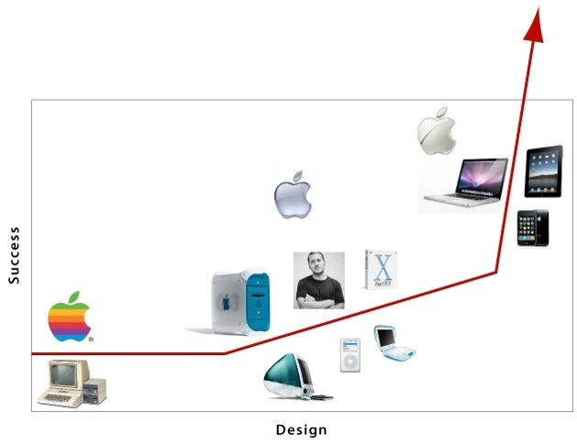
Marketing MIX
For instance:

Slide 10
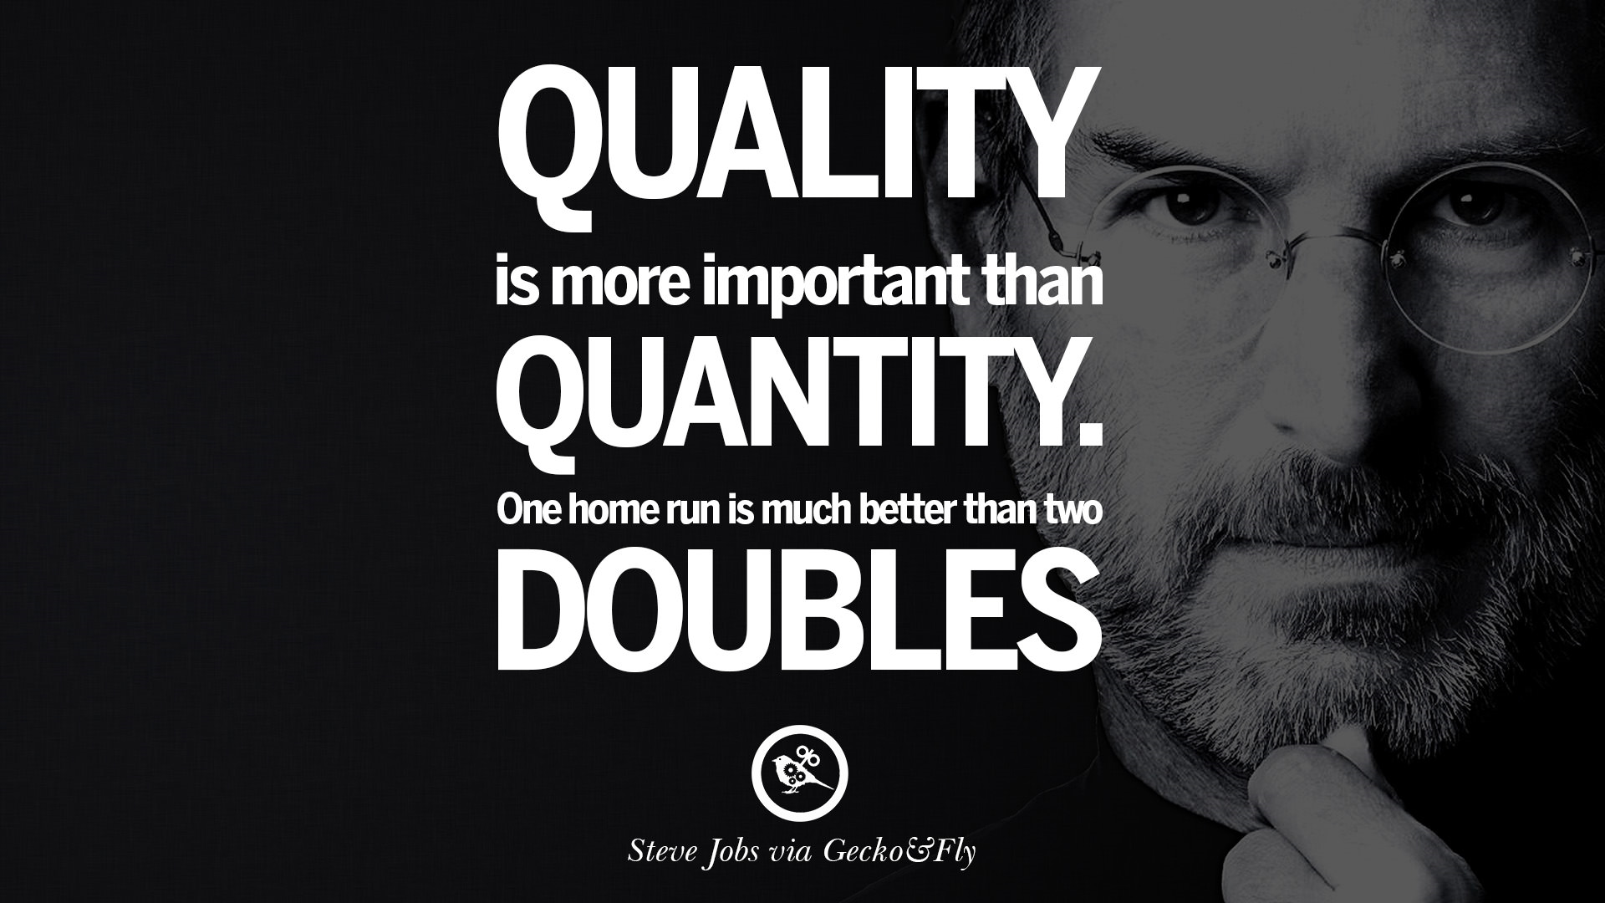
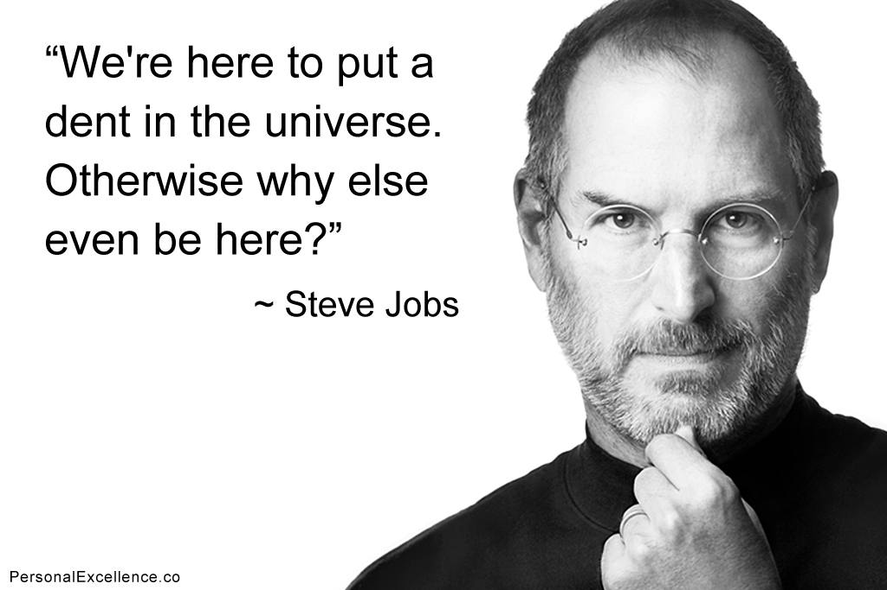
Thanks for your attention
I hope that you enjoyed my presentation as much as i did

